Slide 1
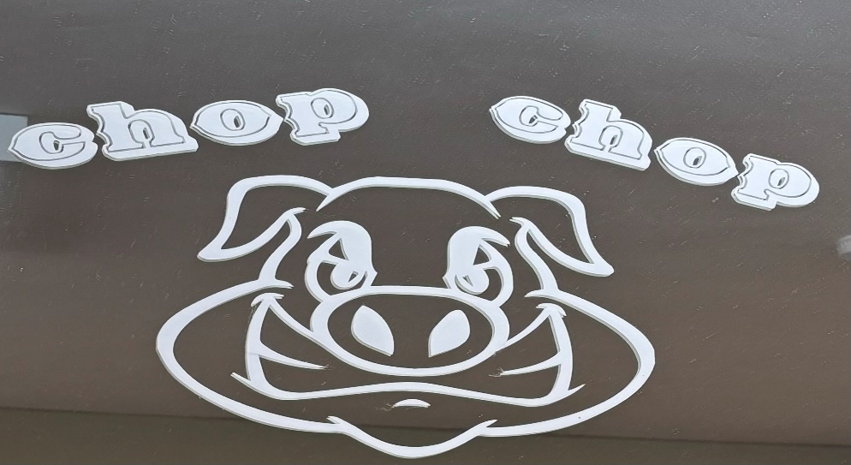
Chop Chop Barbers
This social story has been produced to enhance your visit to ChopChop Barbers by Storyboard

Slide 2
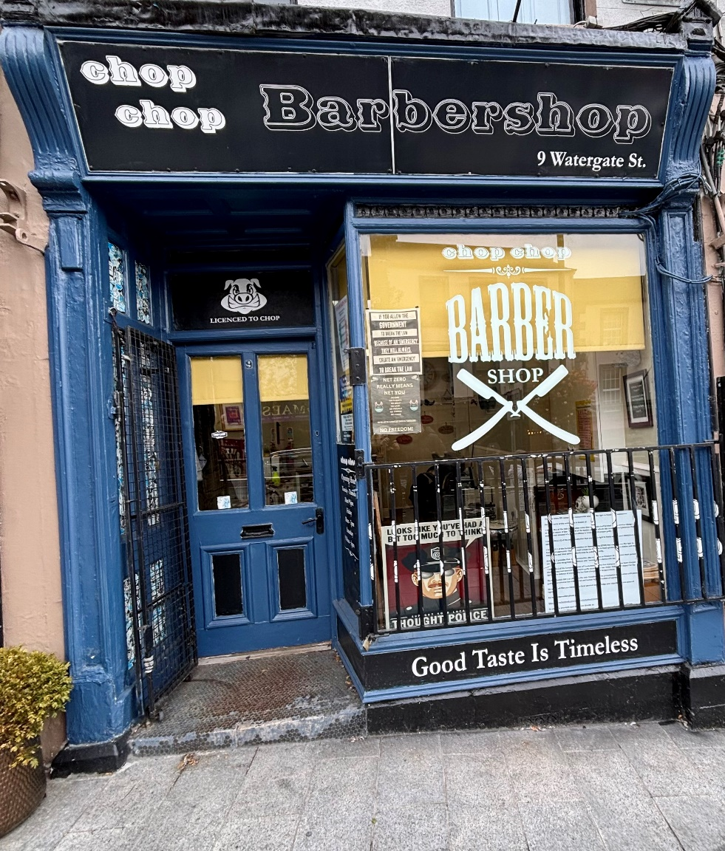
Chopchop’s address 9 Watergate Street, Navan. (opposite the Valley Café)

Slide 3
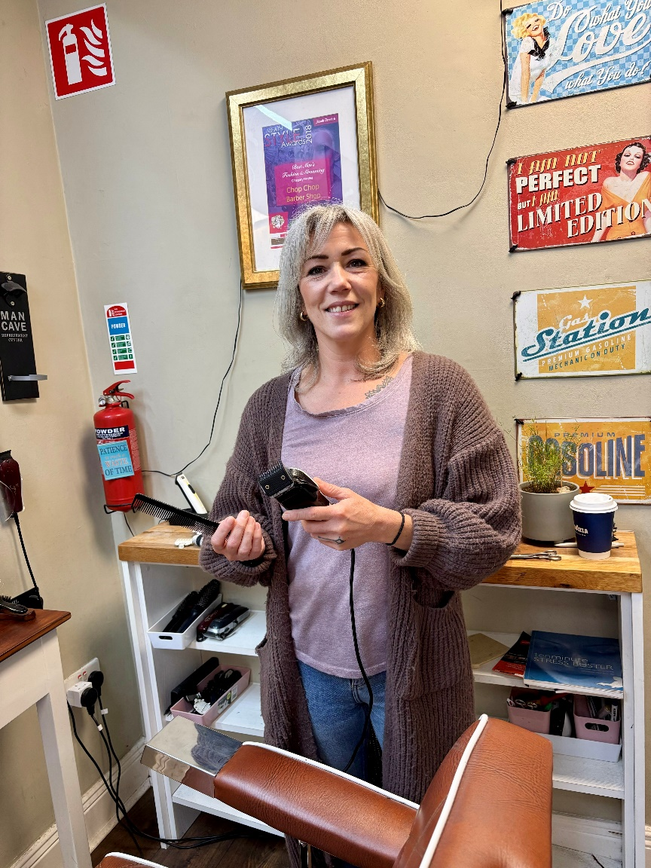
This is Annmarie. She will trim my hair. I can talk to her if I’m scared.

Slide 4
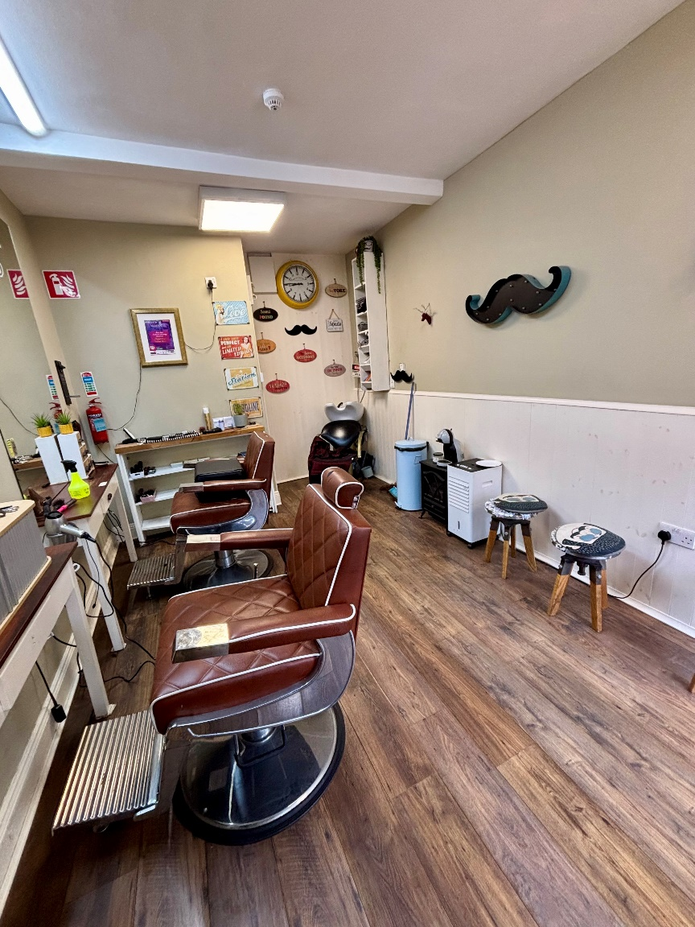
This is what the inside of Chopchop looks like.

Slide 5
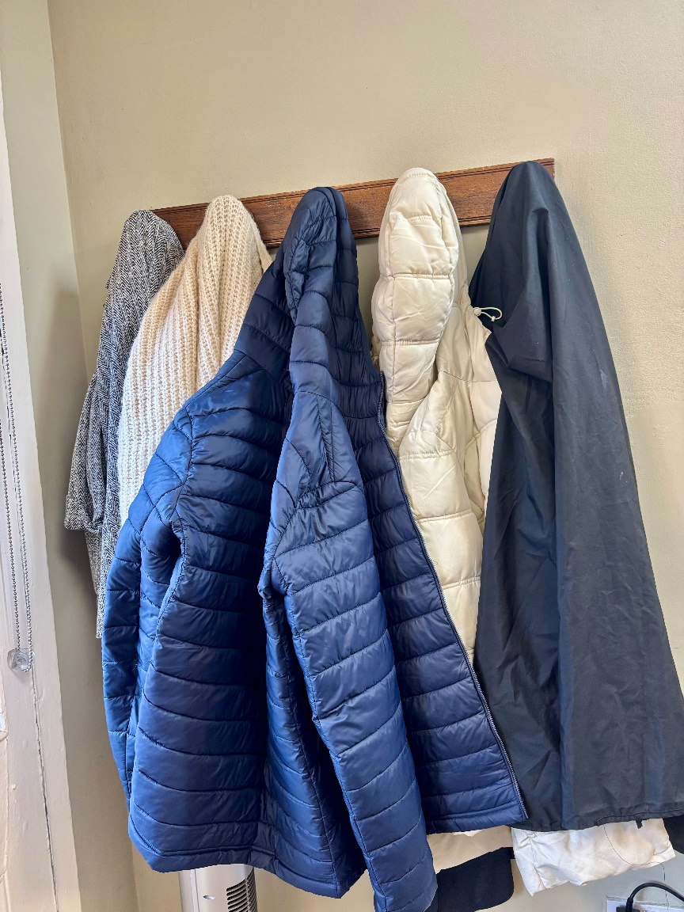
This is where I can hang my coat when I come in the door.

Slide 6
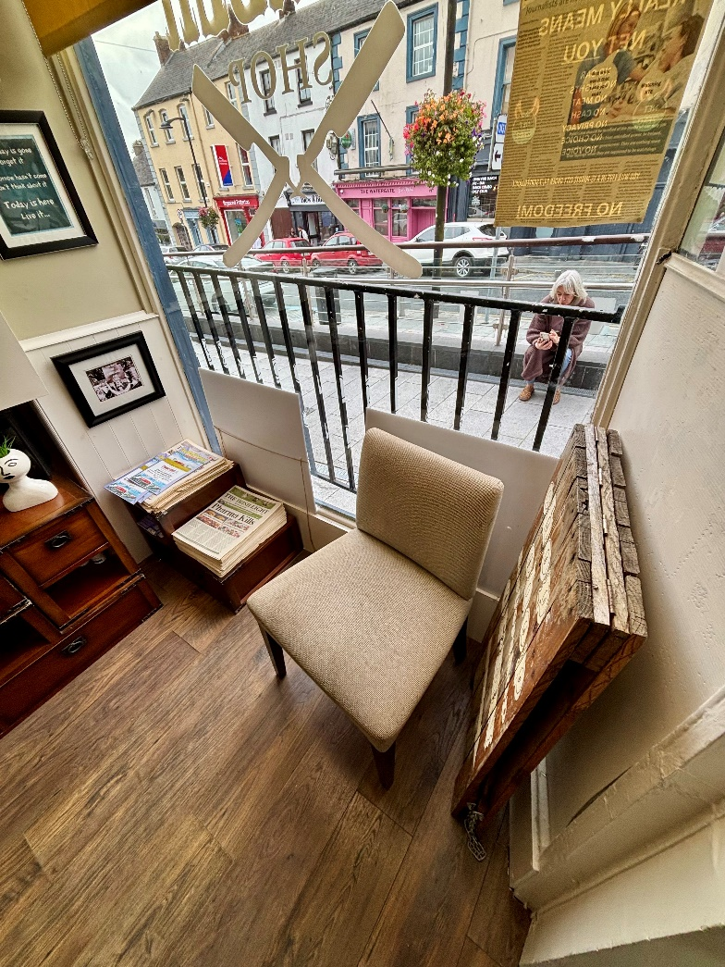
This is where I can sit and wait. I can use my i-pad or play with my toys while I am waiting.

Slide 7
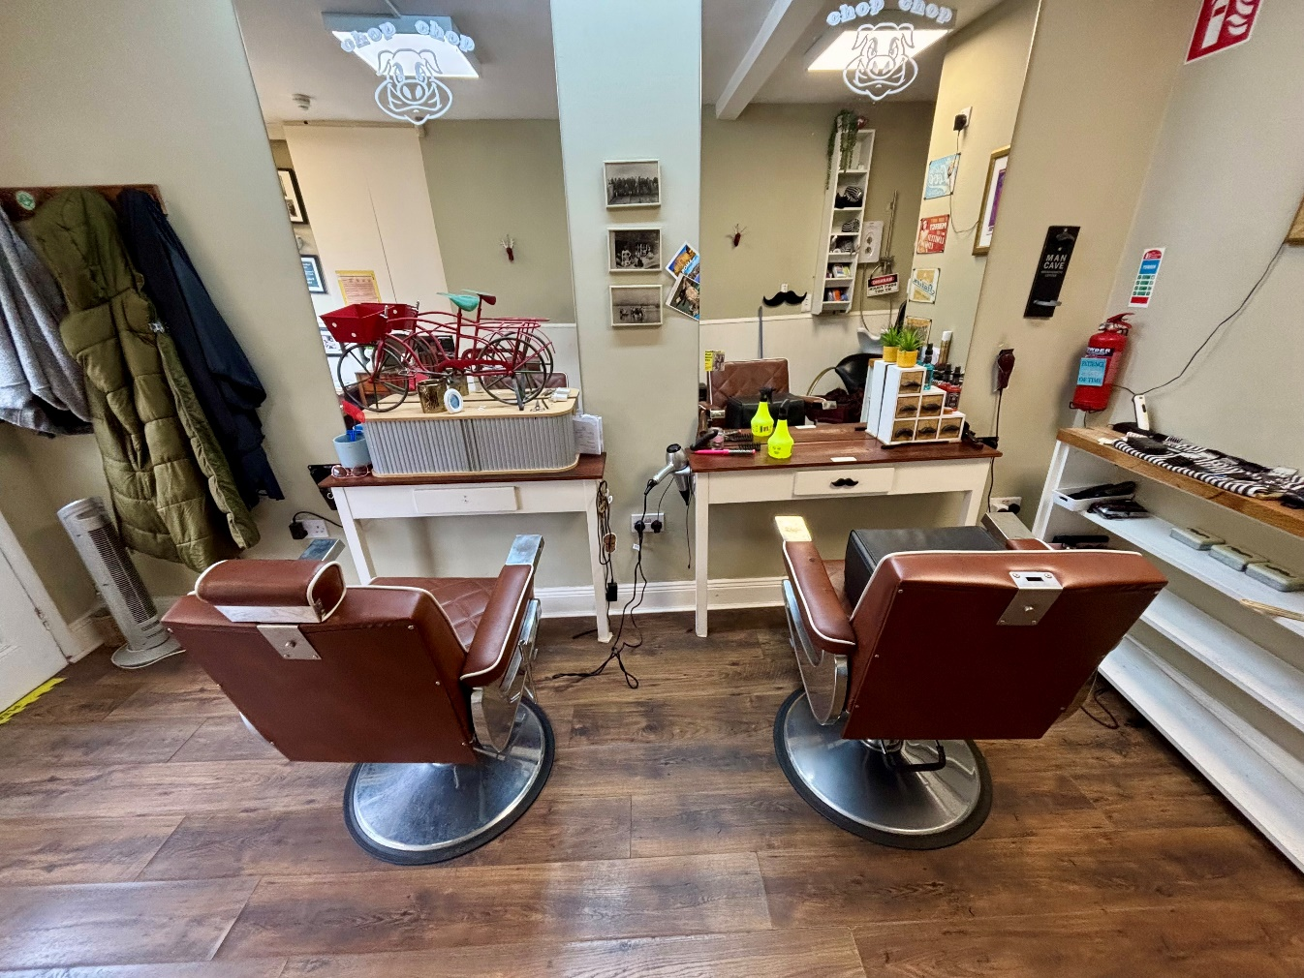
I can sit in one of these seats when AnnMarie is ready to cut my hair.

Slide 8
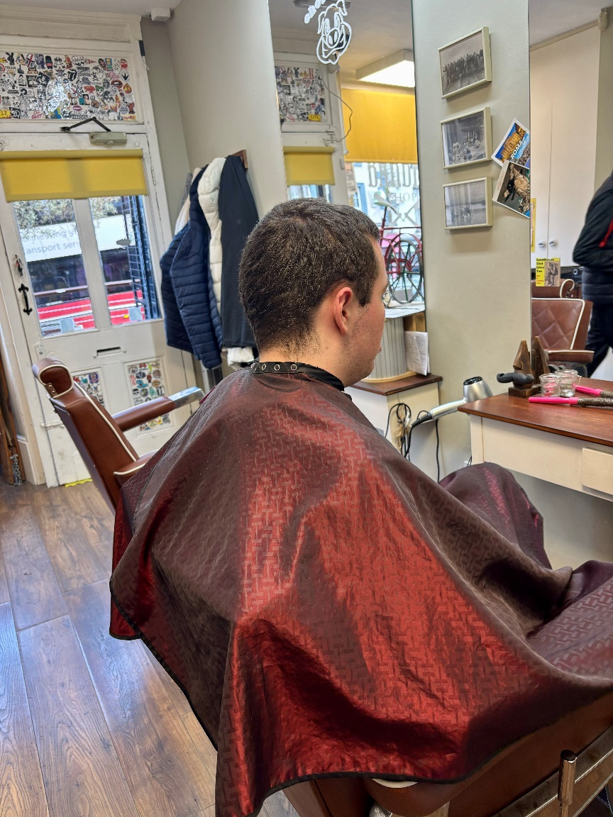
This is the cape I can wear to stop hair getting on my clothes.

Slide 9
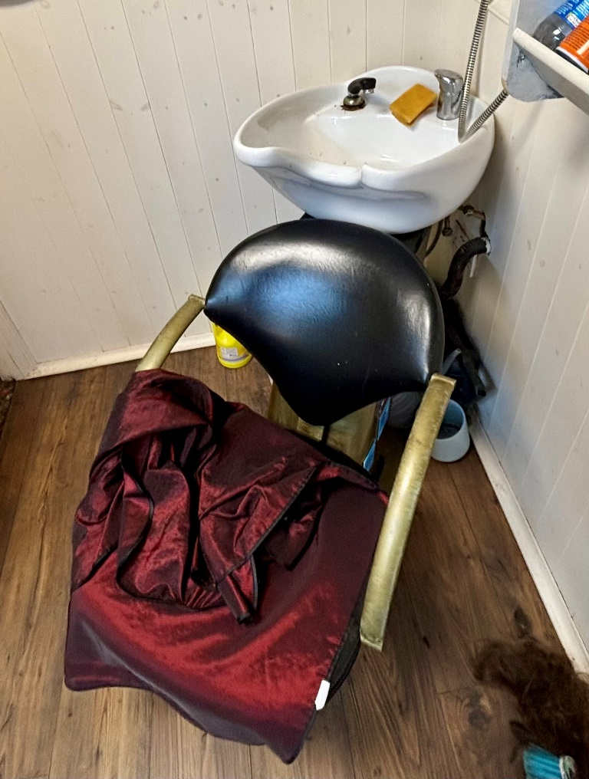
I can sit here if my hair needs to be washed.

Slide 10
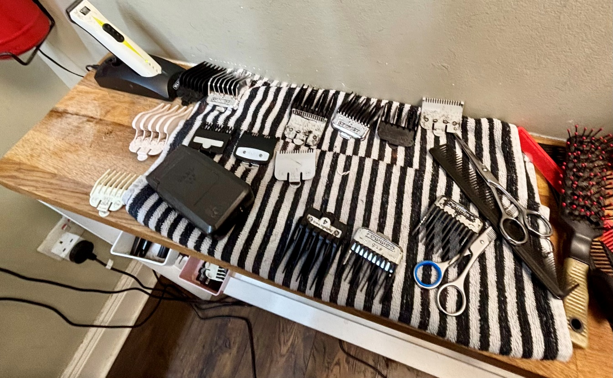
These are tools to help trim my hair. They may look sharp but they don’t hurt at all.

Slide 11
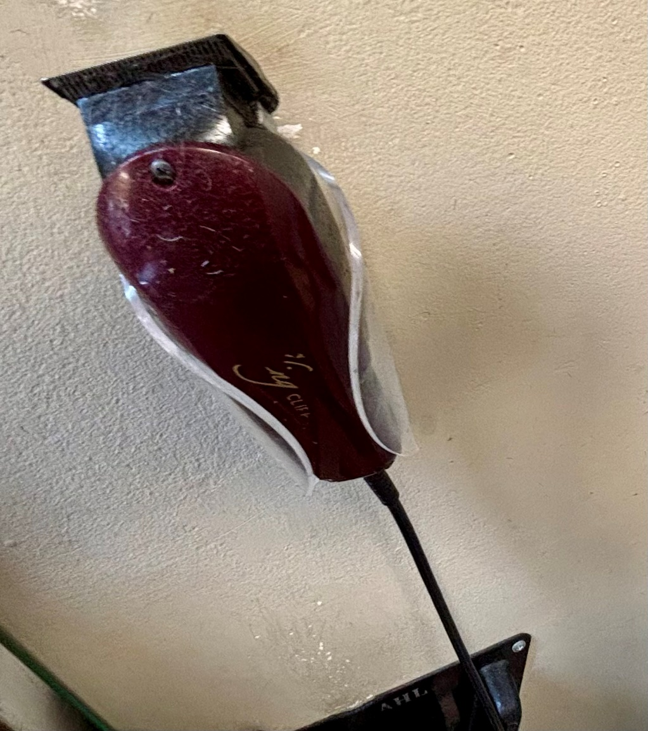
These are the clippers. The make a buzzing sound.

Slide 12
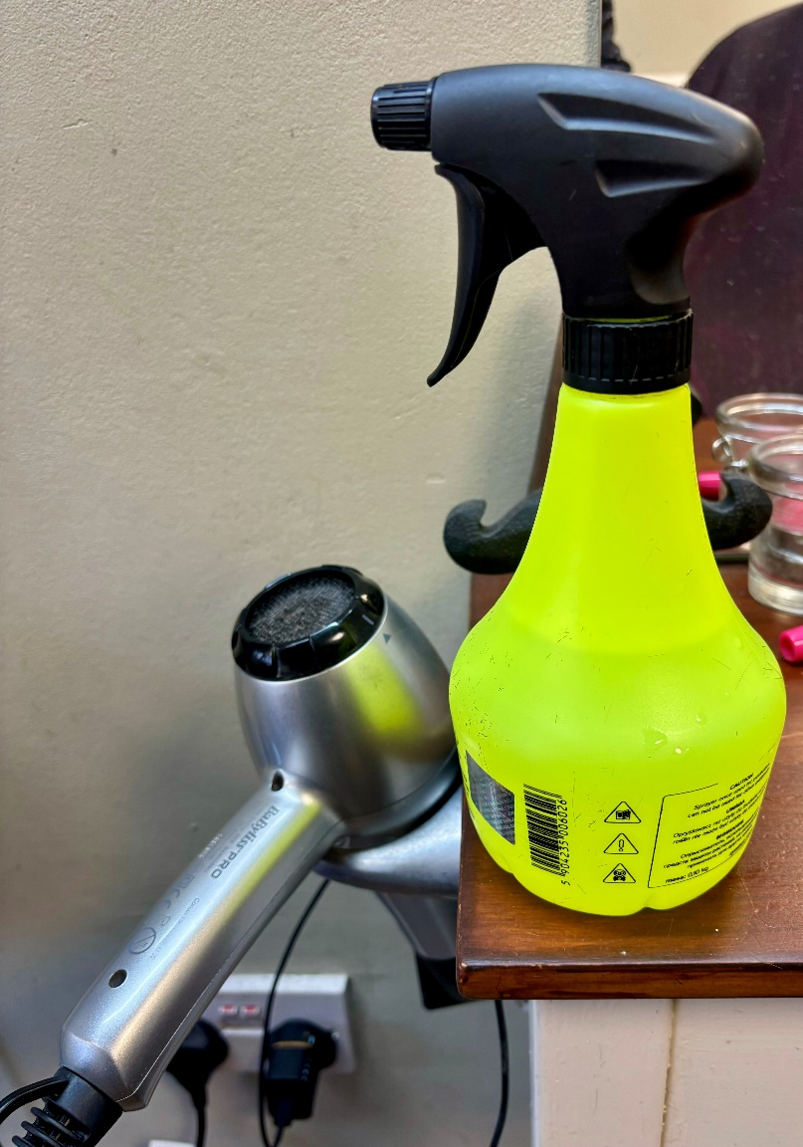
This the water spray bottle. AnnMarie will use it if she is going to use the scissors.

Slide 13
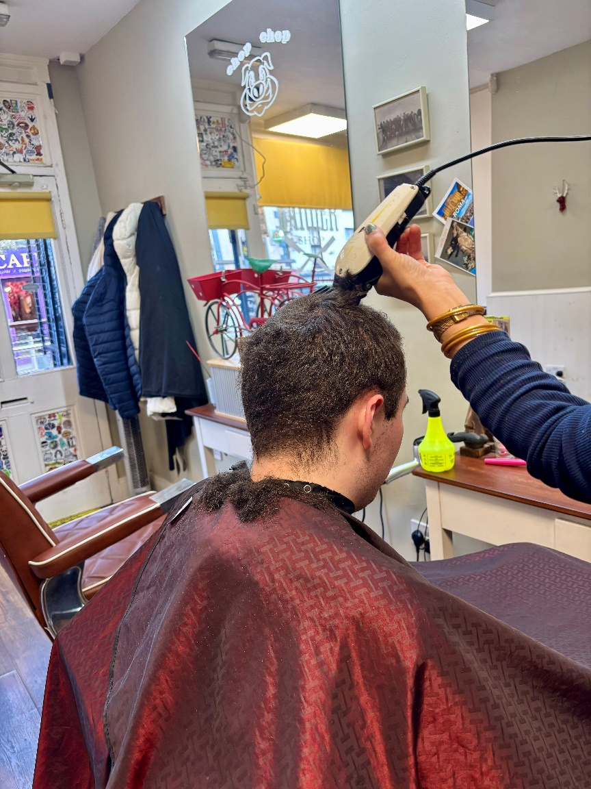
This is what getting your hair trimmed with the clippers looks like. It does not hurt at all.

Slide 14
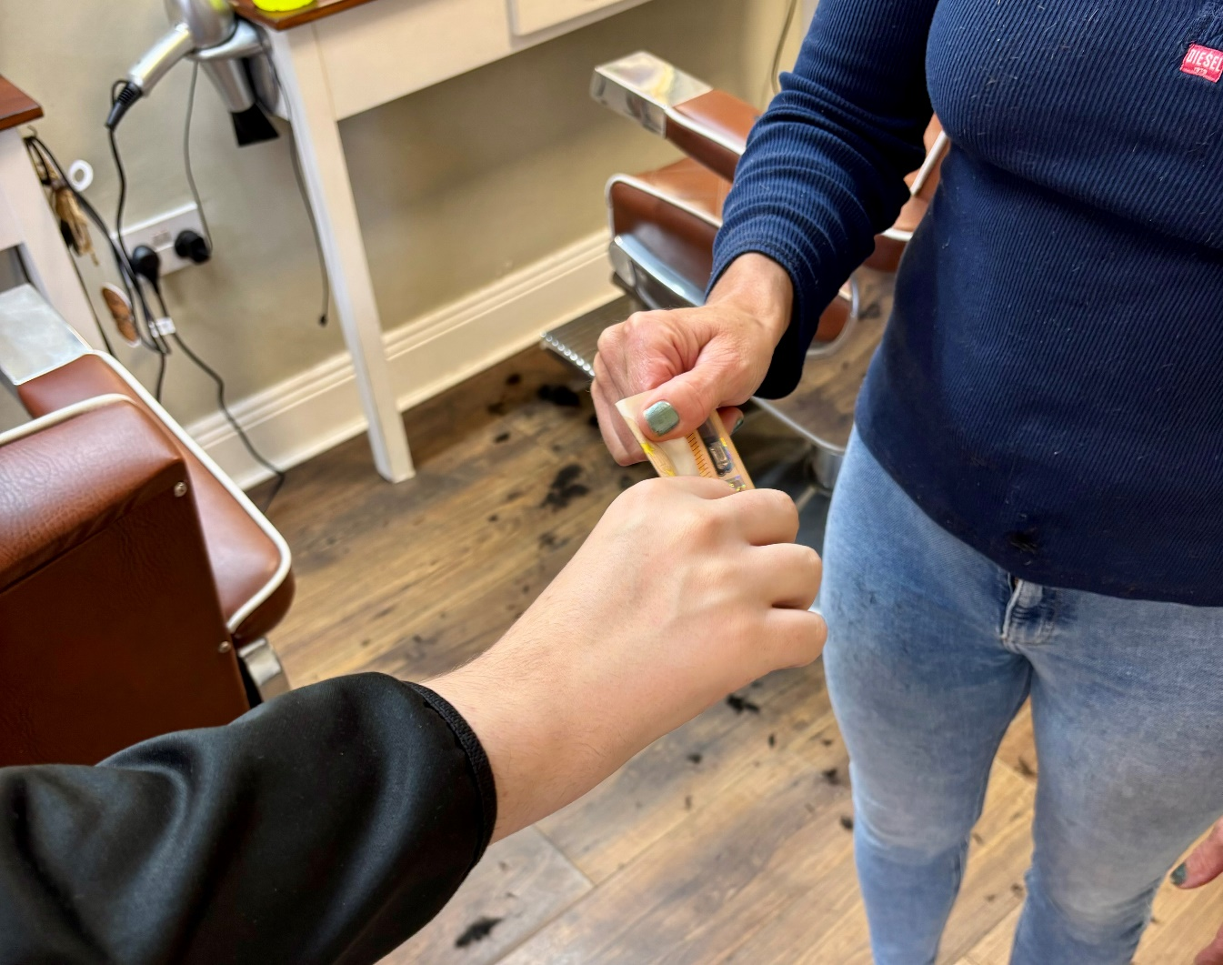
When you are finished you can pay AnnMarie.

Slide 15
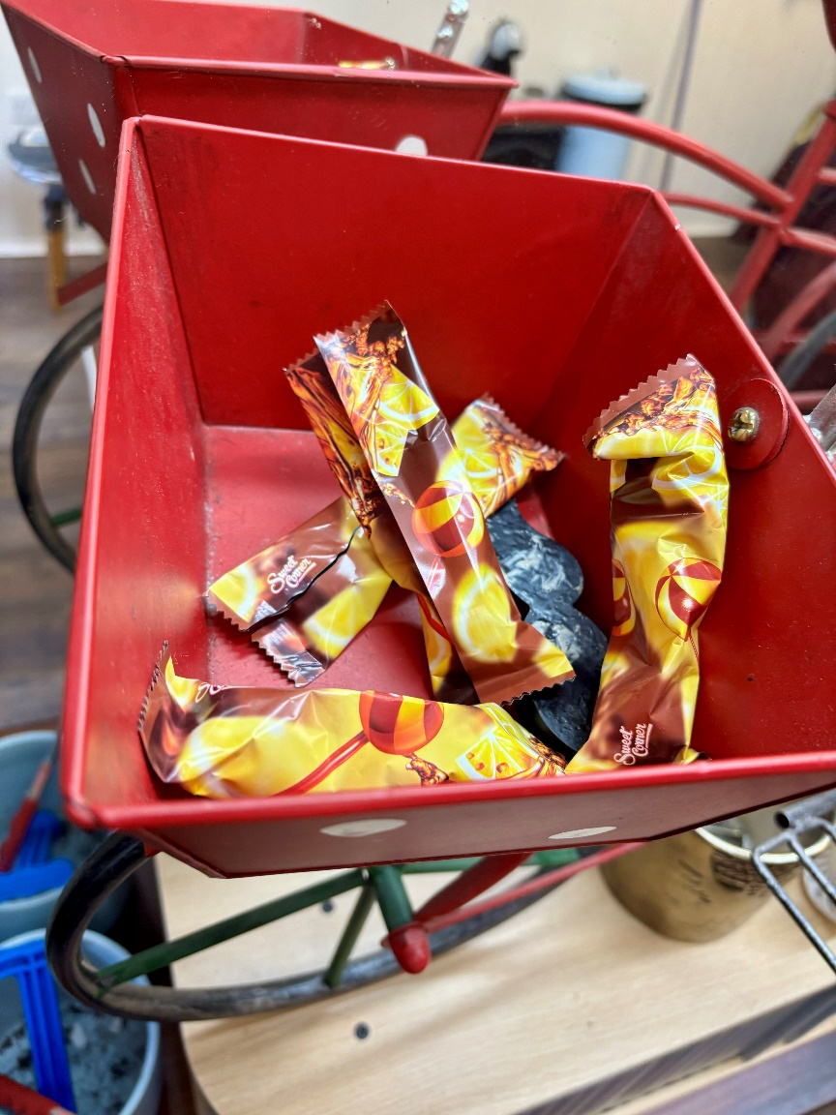
I can take some sweets from the sweet tray. This is my reward.

Slide 16
Now I am finished getting my hair cut.
I am happy with my hair.
Now I will
_______________________________________________________________________________________

Slide 17
ChopChop Barber Shop
9 Watergate Street, Navan
Phone: 086 843 0015
Book here: https://book.heygoldie.com/Chop-Chop-Barbers?fbclid=IwY2xjawIiy3dleHRuA2FlbQIxMAABHV5jfeu4f81HzPNyx4dEMuuoYmMibplqpbnJSRkIS3jTJCp8QlIcG42X3w_aem__1jtJxT5o641fEDX-pswnw

